Slide 1
《Guide to Accessible Inclusion》 Accessible Inclusion Workshop Session II: The Needs of People with disabilities
Sponsored by
Labour and Welfare Bureau
Production

Slide 2
Lesson Review
In the last lesson, we learned:
Different categories of people with disabilities.
The needs of people with physical disabilities.
Everyone is unique, and we should understand and respect each other.
To actively offer help when we see someone in need.

Slide 3
Signs for people with different disabilities

Slide 4
Experiential activity： silent TV

Slide 5
SILENT TV
Divide into groups and take turns, with each group sending a member to use gestures, expressions, and body movements to give hints to other group members, so they can guess the answer to the keyword.
The members responsible for guessing are also not allowed to speak; they can only use paper and pen to answer/communicate. Students, please pay attention to your experiences and feelings during the activity.

Slide 6
Hearing Impaired People
1. A hearing impaired person is a person who has some hearing loss or total hearing loss.
2. Some hearing impaired people need to use hearing aids or sign language to help them communicate in their daily lives. It is very inconvenient for them to communicate with other people if the environment is too noisy or if the other person does not know sign language. Hearing impairment has a major impact on their learning and daily lives.

Slide 7
Hearing Impaired People
3. Hearing impaired people rely heavily on their vision to receive information. Auxiliary aids such as sign language interpreters or visual signalling devices can help hearing-impaired people gain access to important information in the community that would otherwise make it difficult for them to participate in the community.
4. Although hearing impaired people face many difficulties and challenges in their lives, many hearing impaired people in society have made outstanding achievements beyond the hearing barrier.

Slide 8
Learn more about People with Hearing Impairment @方包
https://youtu.be/DY_fRF42v5Q?feature=shared

Slide 9
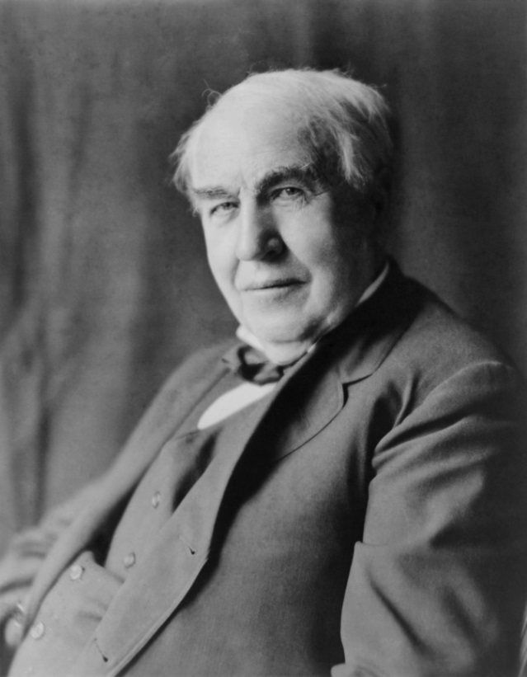
Thomas Edison (1847-1931)
Thomas Edison is one of the world’s most famous scientists, with patents for several important inventions, including the phonograph and the electric light bulb. There are many different stories about Edison's hearing loss, but he had already lost most of his hearing by the age of 12. Rather than being discouraged by his hearing loss, Edison saw it as an asset that allowed him to focus on his experiments and research. Despite Edison's hearing loss, he still managed to invent the phonograph, which some say was able to play material for the blind, similar to today's "audiobooks".

Slide 10
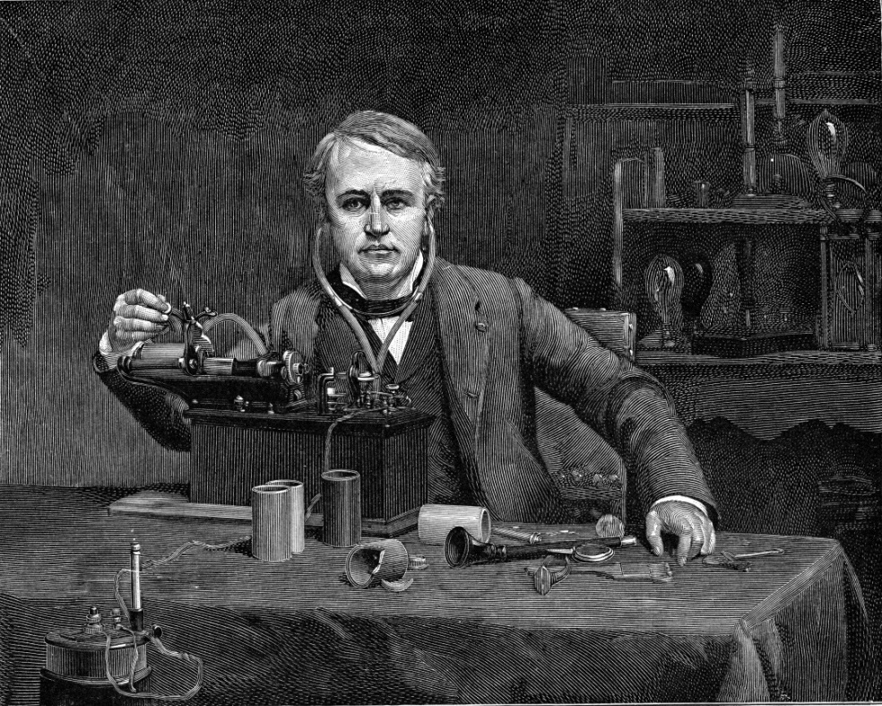
Thomas Edison (1847-1931)
Edison‘s hearing loss didn’t stop him from succeeding, and his inventions have touched the lives of generations of people around the world.
He is an inspirational role model more who has motivated people all over the world.

Slide 11
Experiential activity： Object guessing blindfolded

Slide 12
OBJECT GUESSING BLINDFOLDED
Students take turns being blindfolded/closing their eyes and use their sense of touch to feel and guess what the object is.
Students, please pay attention to your experiences and feelings during the activity.

Slide 13
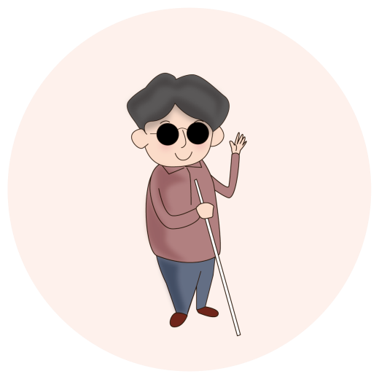
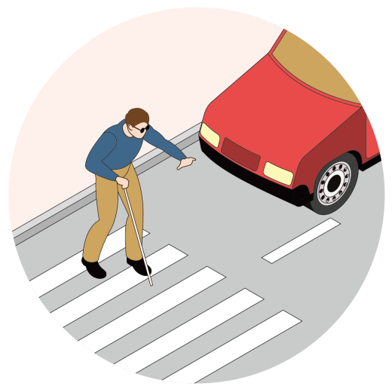
People with Visual Impairment
1. A visually impaired person is a person who has lost some of all of their sight.
2. Some visually impaired people need to use a white cane or guide dog to help them in the street, to avoid knocking things over and to prevent accidents when they go out. If the community does not provide the accessible facilities that visually impaired people need, such as tactile pathways or public announcement systems at bus stops, they can easily get lost when they are out and about.

Slide 14
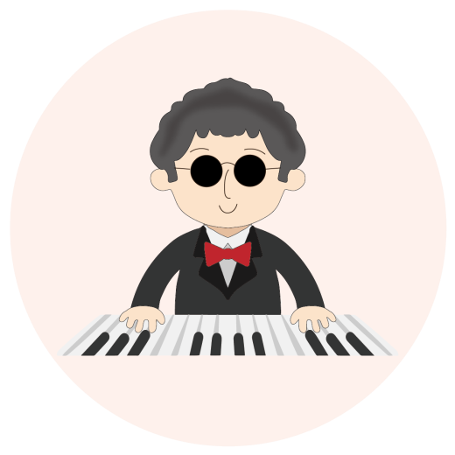
People with Visual Impairment
3. Because their vision is affected, they also face many challenges in their daily lives, such as recognising clothing, reading or using smartphones, etc. They need to use some assistive devices to help them.
4. Although visually impaired people face many difficulties and challenges in their lives, there are many visually impaired people in our society who have made outstanding achievements despite their visual impairment.

Slide 15
Learn more about People with Visual Impairment @面包
https://youtu.be/VDg4L3DnXng?feature=shared

Slide 16
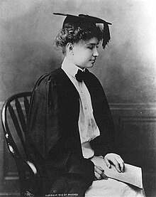
Helen Keller (1880-1968)
In 1924, Helen Keller founded the Helen Keller International. In 1946, she became the International Relations Advisor for the American Foundation for the Blind. She travelled around the world and visited 35 countries, campaigning for the establishment of schools for the blind around the world. She visited patients in hospitals to share her experiences. She also campaigned for the rights of various disadvantaged groups.
Her strong will and dedication have made her a role model for the world to follow.

Slide 17
Helen Keller (1880-1968)
Helen Keller lost her sight and hearing to illness when she was 19 months old. At the age of 7, she learnt to read by having her teacher write on her palm, and within a year she was signing, reading and writing Braille.
At the age of 10, Helen Keller learnt to speak by feeling her teacher’s tongue and lips with her hands and trying to imitate the shape of her teacher’s mouth. Since then, Helen Keller has been an enthusiastic student and learnt five languages. In 1904, she received a Bachelor of Arts degree from Harvard University, becoming the first deaf-blind person to graduate from an institution of higher education.

Slide 18
CONCLUSION
In this class, we learned
The needs of visually impaired individuals.
The needs of hearing impaired individuals.
How to interact with people with disabilities with an inclusive and equal attitude.
How to provide assistance to people with disabilities when needed.

