Slide 1
《Guide to Accessible Inclusion》 Accessible Inclusion Workshop Session III : Accessibility
Sponsored by
Labour and Welfare Bureau
Production

Slide 2
Lesson Review
In last lesson, we learned:
The needs of visually impaired individuals.
The needs of hearing impaired individuals.
How to interact with people with disabilities with an inclusive and equal attitude.
How to provide assistance to people with disabilities when needed.

Slide 3
Understanding Accessible Communities
https://youtu.be/0UOHDw8mas0?feature=shared

Slide 4
ACTIVITY： Facilities CLASSIFICATION

Slide 5
FACILITIES CLASSIFICATION
Each group draws a disability category card and receives a picture of an auxiliary tool/accessibility facility.
Each group identifies the auxiliary tools/accessibility facilities related to their disability category and guesses how these tools or facilities help people with that specific disability.

Slide 6
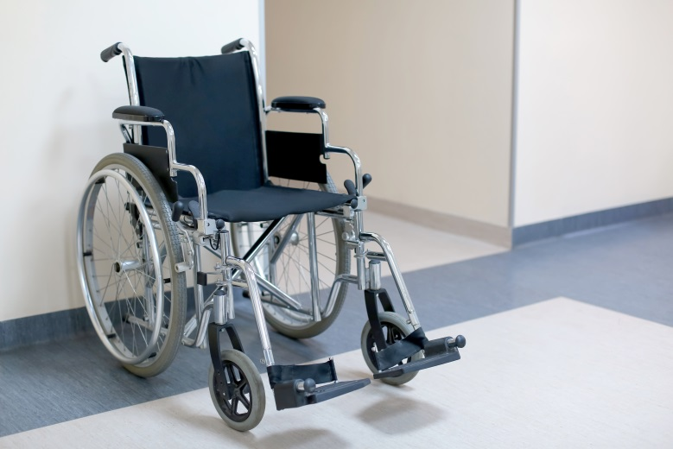
Auxiliary devices for people with physical disabilities
(1) Wheelchair
Convenient for those who cannot walk for a long time to go out.

Slide 7
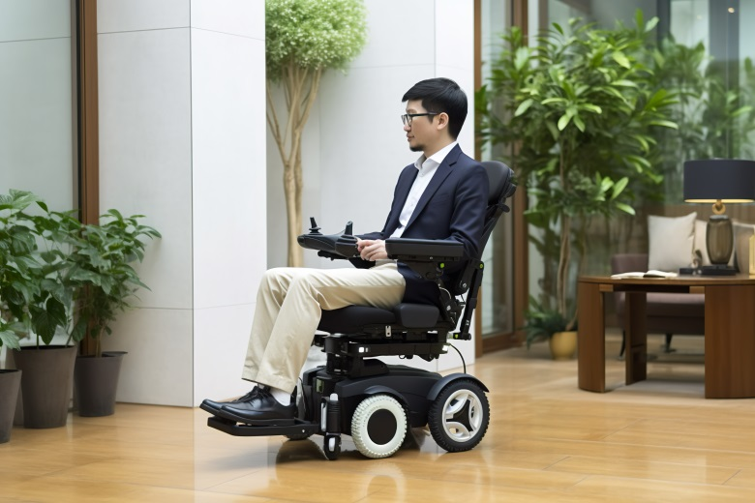
Auxiliary devices for people with physical disabilities
(2) Powerchair
A wheelchair that is electrically powered and does not need to be pushed by the disabled person or others.

Slide 8
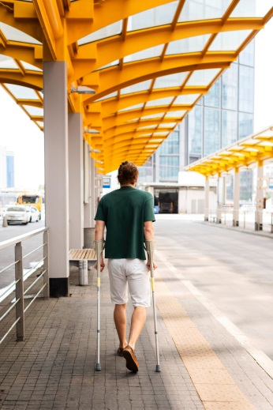
Auxiliary devices for people with physical disabilities
(3) Cane
Used for support and balance, it helps people with limited mobility to walk.

Slide 9
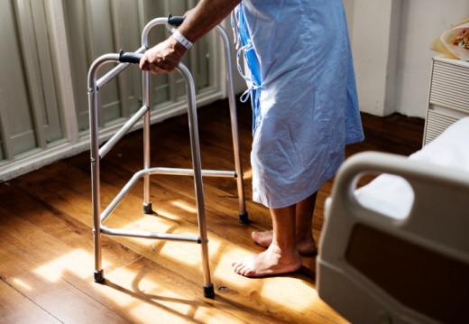
Auxiliary devices for people with physical disabilities
(4) Walking Frame
Used for support and balance, it is more stable than using a walking stick and helps people with mobility problems to walk.

Slide 10
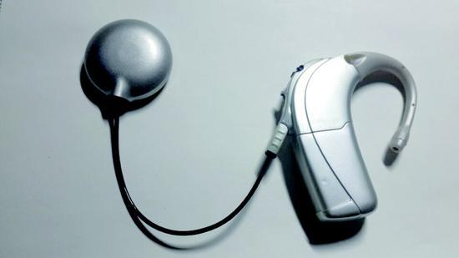
Auxiliary devices for people with HEARING IMPAIRMENTS
(1) Hearing Aids
Amplified sound for hearing impaired people to hear sound and speech.

Slide 11
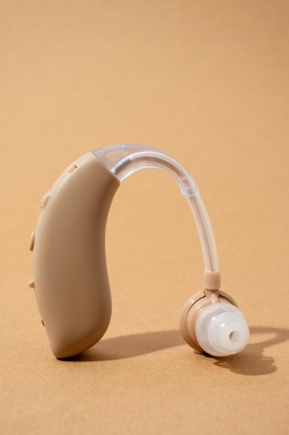
Auxiliary devices for people with HEARING IMPAIRMENTS
(2) Cochlear Implants
Implanted in the ear, it can act as a sound transmitter.

Slide 12
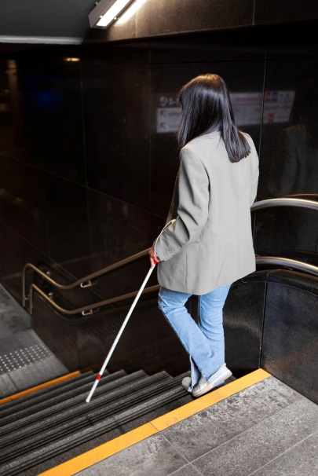
Auxiliary devices for people with visual impairments
(1) White Cane
Allows the user to observe what is in front of them by swinging the white cane.

Slide 13
Auxiliary devices for people with visual impairments
(2) Magnifier
Zoom in on the text or images to make them easier to read.

Slide 14
Auxiliary devices for people with visual impairments
(3) Braille Machine
Converts words into raised dots, allowing the visually impaired to understand the text by touching it with their fingers.

Slide 15
Learn more about Guide Dogs
https://youtu.be/5GlLp2daugY?feature=shared

Slide 16
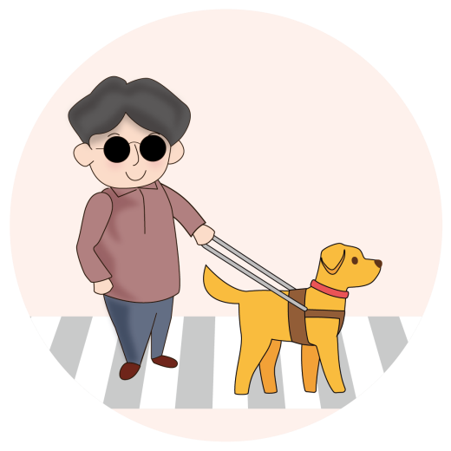
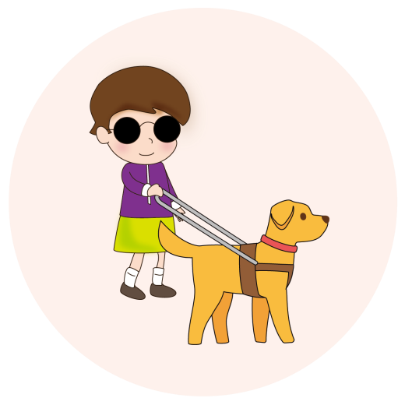
Guide dogs
1. A guide dog acts as a second pair of eyes for a visually impaired person, guiding them along the way.
2. Guide dogs are not like taxis that take the visually impaired directly to their destination. The guide dog user needs to know how to get to their destination and then instruct the guide dog to go straight ahead or make a turn, while the guide dog is responsible for guiding the visually impaired person without falling or bumping into anything.

Slide 17
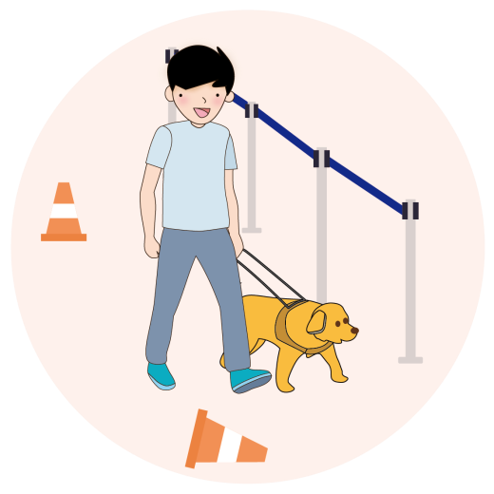
Guide dogs
It takes a year to train a guide dog, first to learn to stay at home and then to adapt to different environments, such as shops and markets. Dog treats are used as a reward during training to help the dog learn to obey different commands. After training, the guide dog is matched with a visually impaired person. If the two can get along, the guide dog is used to help the visually impaired person go out safely.

Slide 18
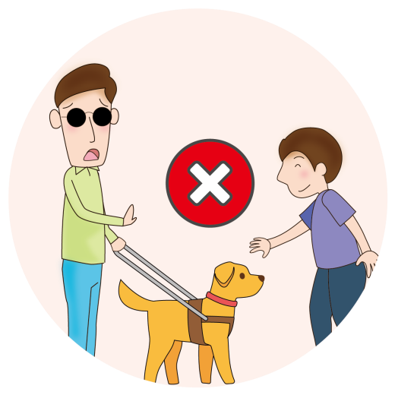
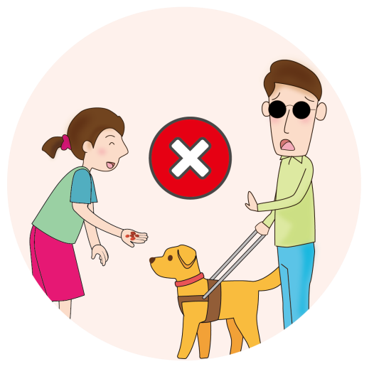
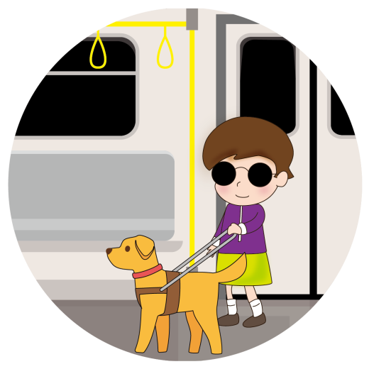
Guide dogs
If you see a guide dog at work on the street, please remember the “Three No’s and One Question”.
不不干擾：
干擾：
One question
If you see visual impaired people in need, you can take the initiative to ask them if they need help. If you want to meet a guide dog, you must ask the guide dog owner for permission.
No interference
Do not attract a guide dog with noises or gestures, and do not pet it.
No feeding
Do not attract or feed a guide dog with any food.
No refusal
Guide dogs are welcome in public places.

Slide 19
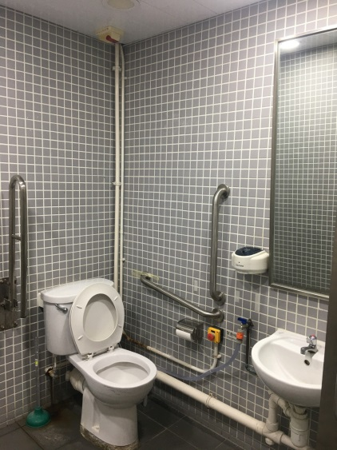
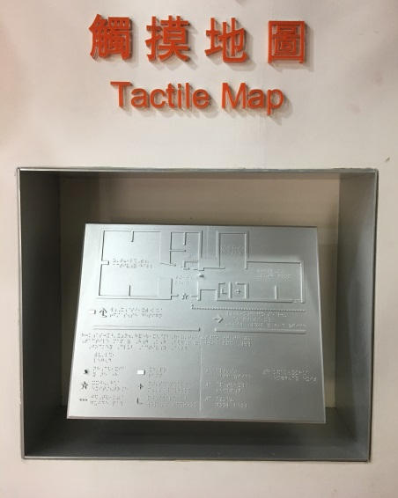
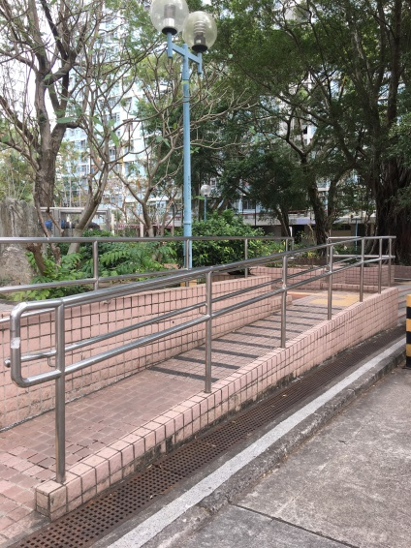
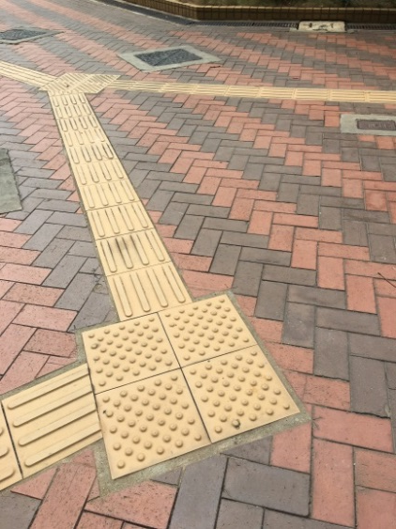
Accessible Facilities
Common accessible facilities include:
不不干擾：
干擾：
Ramp
Allows wheelchair users to get on and off at different points.
Accessible Toilet
Toilets that are accessible to those with special needs, such as wheelchair users.
Tactile Pathways
To guide people with visual impairments to a safe destination.
Braille and Tactile Map
Maps suitable for the visually impaired.

Slide 20
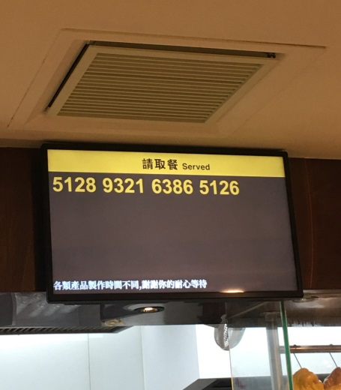
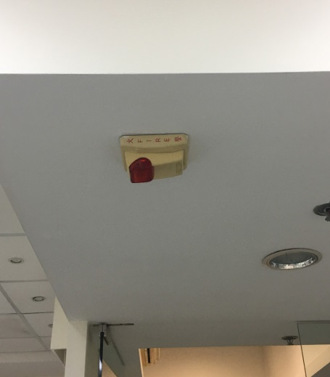
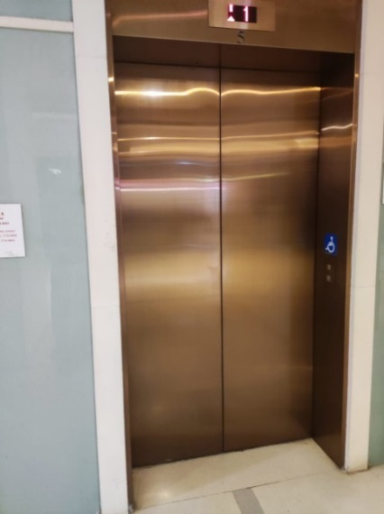
Accessible Facilities
Common accessible facilities include:
不不干擾：
干擾：
Luminous Display
To enable visually and hearing impaired people to access the text information they need.
Visual Fire Alarms
The light lets the hearing-impaired know there is a fire.
Elevator
Allows different people to reach the floor they need to go to.

Slide 21
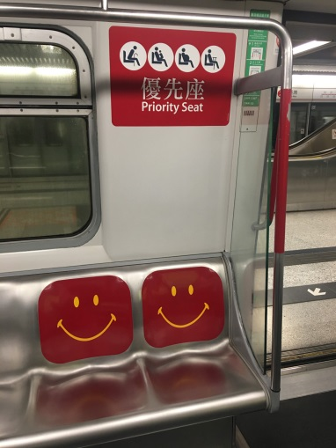
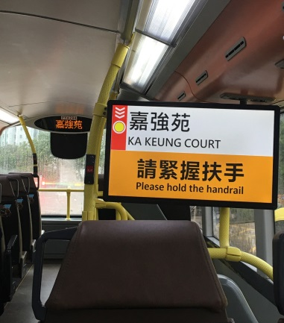
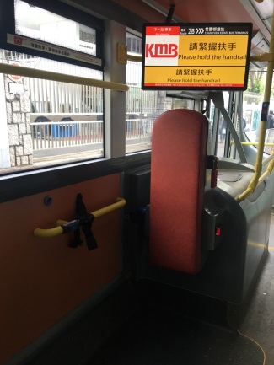
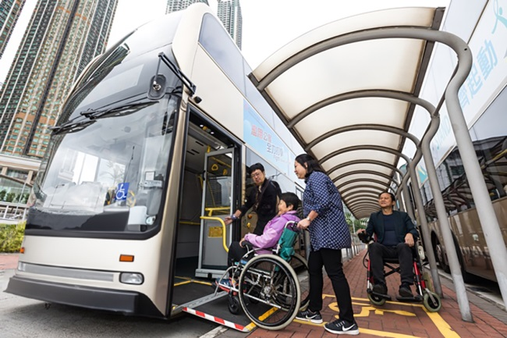
Accessible Transport
Common accessible transport services and facilities in Hong Kong include:
不不干擾：
干擾：
Priority Seating
Seats for people in need, including people with disabilities, who have priority to sit down and rest.
Station Announcement System
Use voice or display screens to inform passengers, including those with visual or hearing impairments, of their location.
Wheelchair spaces
Provide a space on the bus for wheelchair users.
Low-floor / low-entry vehicles
To make it easier for wheelchair users to get on and off the vehicle.

Slide 22
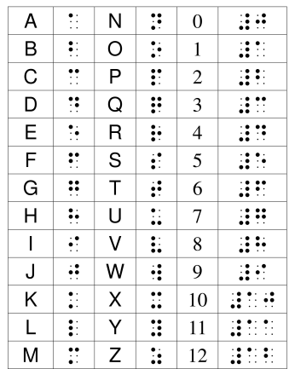
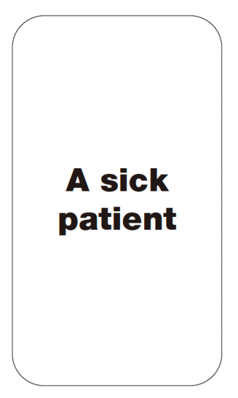
Accessible Information
Common services in Hong Kong that make information accessible to people with disabilities include:
不不干擾：
干擾：
Braille
Text that helps visually impaired people to read by touching the text with their fingers.
Sign Language Translation
Interpretation of sign language and speech to facilitate communication for the hearing impaired.
Flashcards
Cards with pictures and simple words help people with hearing or speech impairments to express themselves.

Slide 23
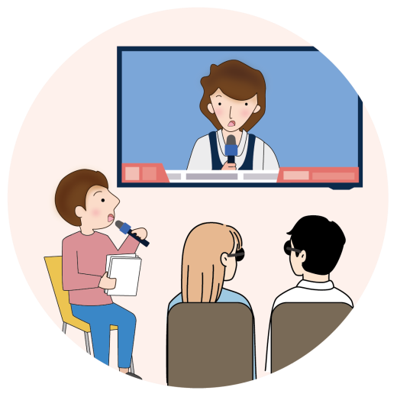
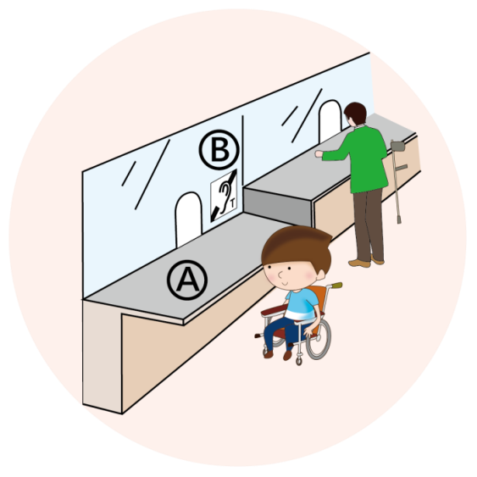
Accessible Information
Common services in Hong Kong that make information accessible to people with disabilities include:
Audio Description
The information in the video is narrated in sound so that the visually impaired can understand it.
A Low Reception Desk
To make it easier for wheelchair users to meet and communicate with staff.
B. Inductive Loop System
Helps people with hearing aids to hear audio.

Slide 24
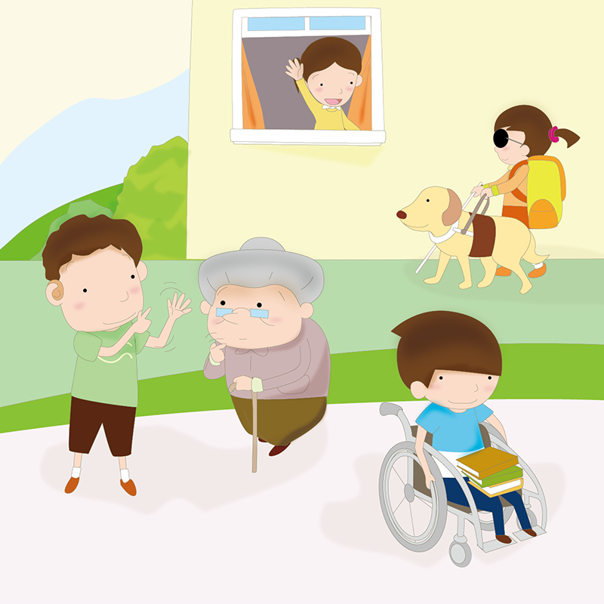
ACCESSIBLE COMMUNITY
Accessible facilities and services not only benefit people with disabilities but also provide convenience to various other groups in society, including the elderly, pregnant women, and workers pushing heavy loads.

Slide 25
Thematic activity： our new CLASSMATES

Slide 26
OUR NEW CLASSMATES
Each group draws a role card, which represents a new classmate with different needs.
Each group discusses what accessible facilities in the school can help this new classmate and what facilities need improvement.
Each group designs an inter-class trip itinerary suitable for the new classmate based on their role card.

Slide 27
CONCLUSION
In This Class, We Learned:
The uses and importance of different auxiliary tools and accessible facilities.
Accessible facilities are not only designed for people with disabilities but also provide convenience for everyone.
Whether at school or in the community, we can all do our part to create a friendlier and more accessible environment.

