Slide 1
《Guide to Accessible Inclusion》 Accessible Inclusion Workshop Session V: Inclusion
Sponsored by
Labour and Welfare Bureau
Production

Slide 2
Lesson Review
In the last lesson, we learned:
Not to hold stereotypical impressions or thoughts about people with disabilities.
Everyone has the ability to contribute to society, regardless of whether they have a disability.
To maintain an open and inclusive attitude towards everyone.
Students can assess their own strengths and learn how to use their strengths to help others and contribute to society.

Slide 3
Getting Alone with People with Disabilities
https://youtu.be/66MUFNeucCw?feature=shared

Slide 4
Experiential activity： guiding the visually impaired

Slide 5
EXPERIENTIAL ACTIVITY
1. Students take turns playing the roles of a leader and a visually impaired person. Leader try to lead the visually impaired person while walking.

Slide 6
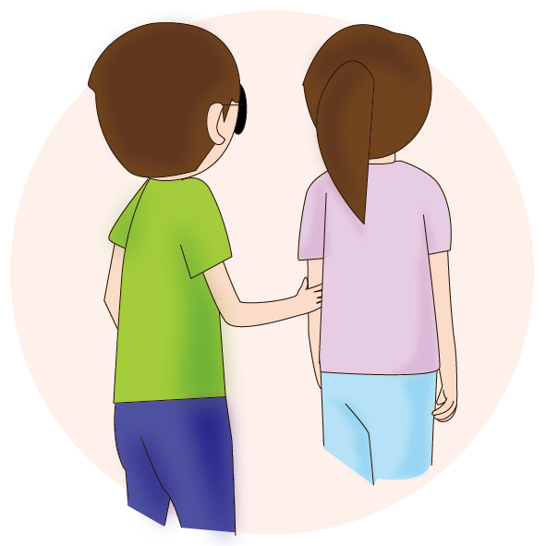
Guiding the Visually Impaired
First, tell the visually impaired person that they are being guided. The guide should touch the visually impaired person's hand lightly with the back of the hand so that the visually impaired person can locate the guide’s position.
The visually impaired person should hold the guide’s upper elbow.
The guide should stand about half a step in front of the visually impaired person.

Slide 7
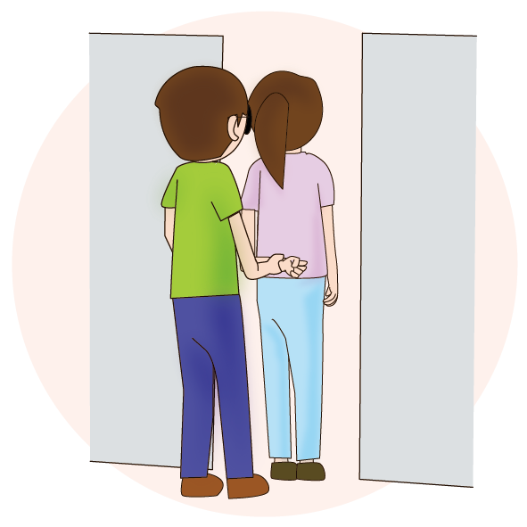
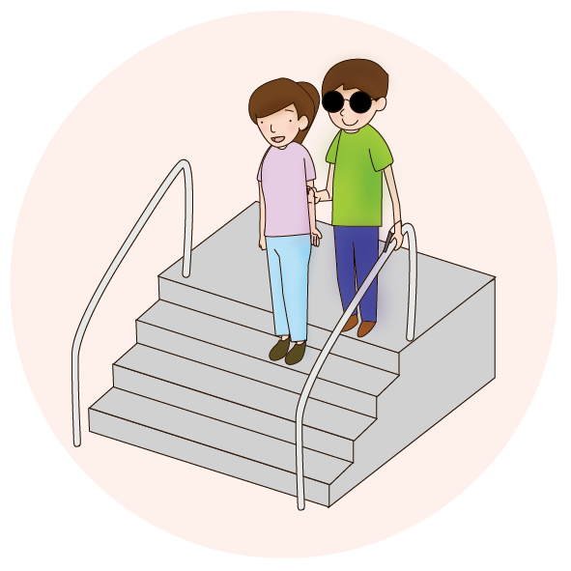
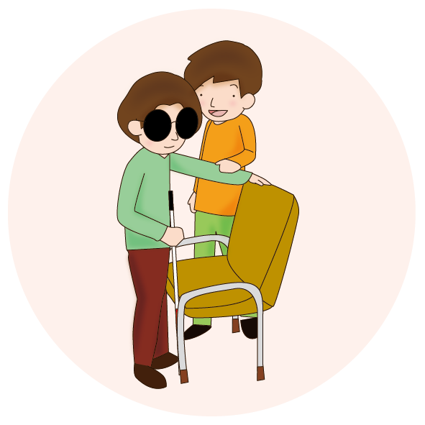
Guiding the Visually Impaired
Walk with the above holding position and distance, keeping an eye on the speed of both parties.
When passing through narrow passages, the guide should bend the arm being held and put it behind the back. The visually impaired person will then switches to holding the guide’s wrist. The two should walk in unison at a reduced speed.
When walking up and down the stairs, the visually impaired person should be told to start walking up or down the stairs. The guide should take one step away from the visually impaired person and place the other hand on the handrail.
When guiding the visually impaired person to sit down, the guide could lead the visually impaired person to the back of the chair and then allow the visually impaired person to find their way down to the seat.

Slide 8
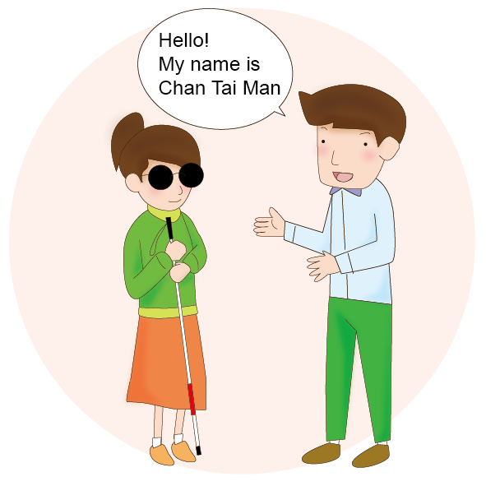
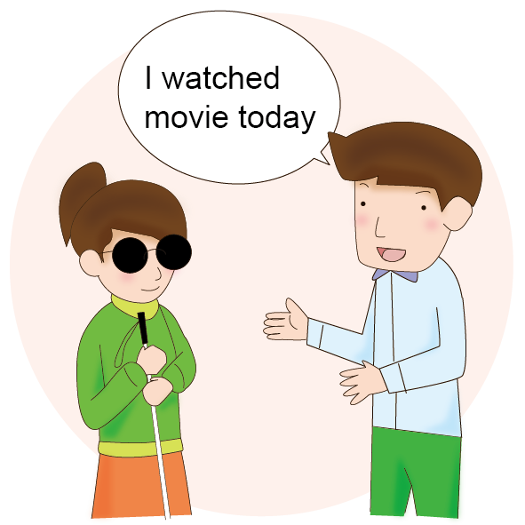
People with Visual Impairment
When you are talking to them, you should first introduce yourself and let them know who you are.
There is no need to deliberately avoid using the words “see” or “look”.

Slide 9
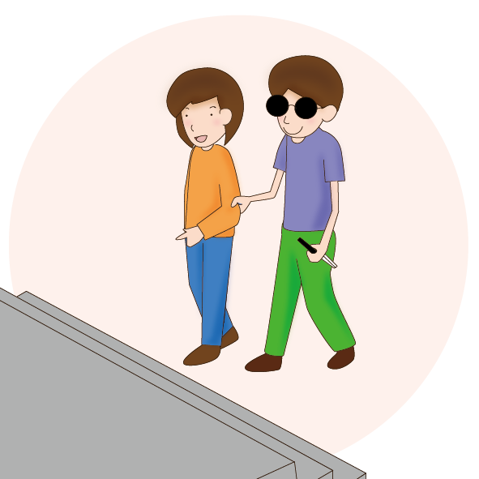
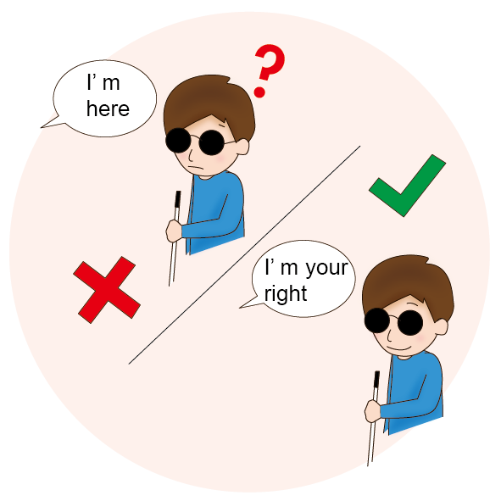
People with Visual Impairment
If you are travelling with them, you can let them hold on to your arm or shoulder so that they can tell if they are walking on a road or stairs.
Instead of using fingers or saying “this way” and “that way” to indicate directions, tell them to turn left or right.

Slide 10
People with Visual Impairment
When guiding the visually impaired person to sit down, the guide could lead the visually impaired person to the back of the chair and then allow the visually impaired person to find their way down to the seat.

Slide 11
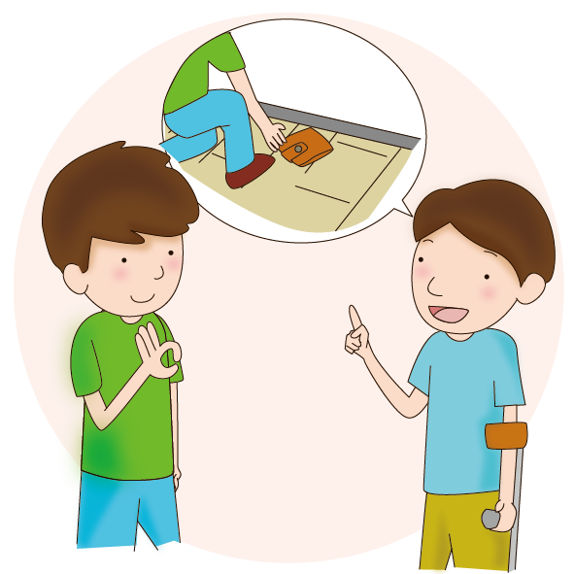
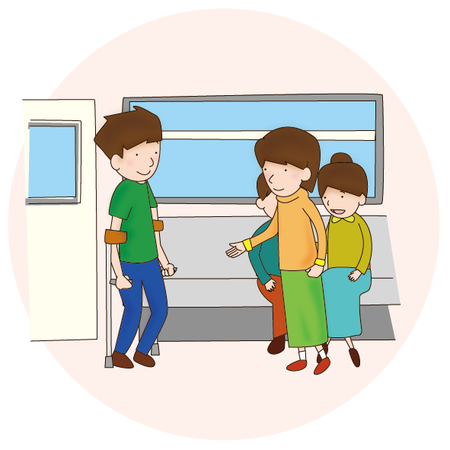
People with physical disabilities
Listen to their needs before offering assistance.
Give way to people who use aids such as crutches to help them walk.

Slide 12
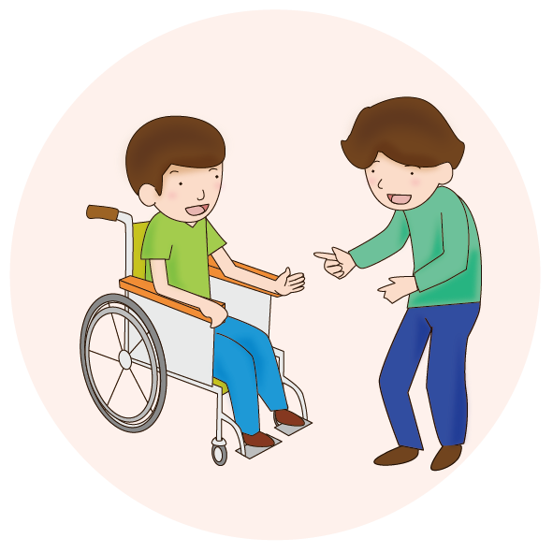
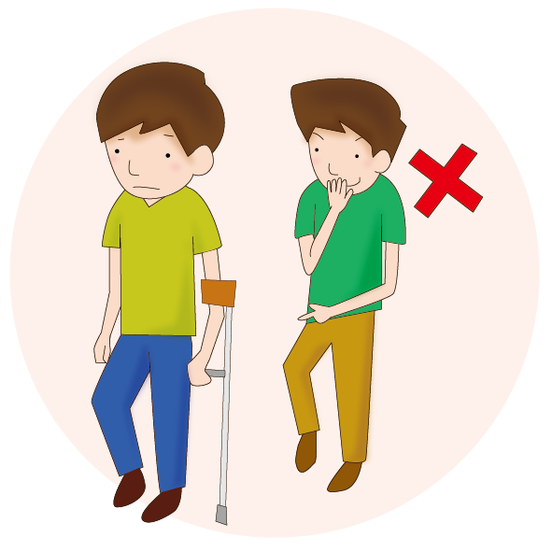
People with physical disabilities
Sit down and talk to wheelchair users, or talk to them at eye level.
Do not imitate or laugh at their behaviour because of their disability.

Slide 13
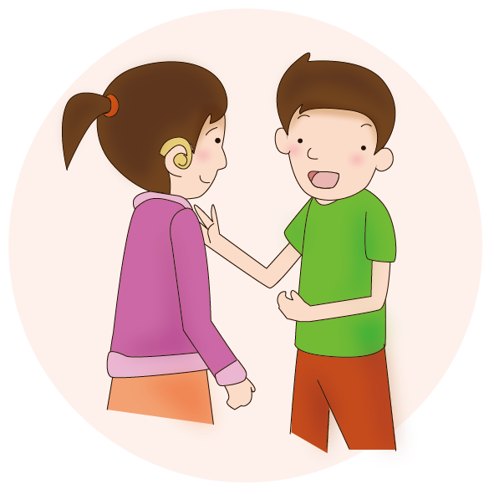
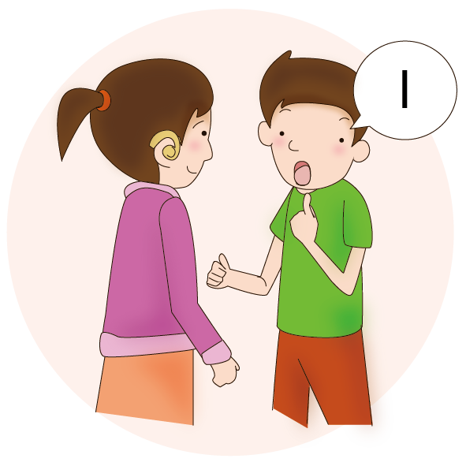
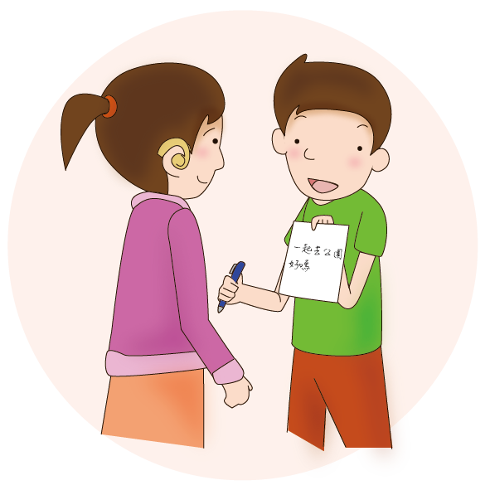
People with hearing impairments
Communicate with them face to face so they can see the speaker’s mouth.
Speak as briefly and clearly as possible, using gestures, facial expressions and body language.
Pen and paper can be used to aid communication if necessary.

Slide 14
Simple Sign Language

Slide 15
Simple Sign Language

Slide 16
The Convention on the Rights of Persons with Disabilities
States parties to the Convention work together to promote the full and equal enjoyment of human rights and fundamental freedoms by all individuals with disabilities.
The Convention entered into force in China in 2008. As a part of China, Hong Kong is obliged to comply with the Convention and to work together to create an accessible society.

Slide 17
Thematic activity： Promotion Inclusion

Slide 18
Promotion Inclusion
Group Discussion: As primary school students, how can we promote social inclusion for people with disabilities?
Each group proposes at least three specific suggestions or action plans.
Then, draft and sign "Our Accessibility Charter" together as a commitment to promoting social inclusion for people with disabilities.

Slide 19
CONCLUSION
In Different Classes, We Learned:
The abilities and needs of different people with disabilities.
The importance of auxiliary tools and accessible facilities/services.
To put ourselves in others' shoes and maintain an open and inclusive attitude towards everyone.
Not to underestimate our own power; we can also do our best to promote social inclusion for people with and without disabilities.

